Slide 1
Analyzing Measurement Data
Chapter 6

Slide 2
Probability Distribution
A probability distribution for an experiment is the assignment of probability values to each of the possible outcomes.
A probability density function (PDF) is a mathematical function that describes a continuous probability distribution. It provides the probability density of each value of a variable.
Example
Normal (Gaussian) Distribution
Exponential Distribution
Chi-Square Distribution
…

Slide 3
Classical Data Analysis Techniques
After collecting relevant data we must analyze it appropriately. We need a proper understanding of the following notions:
Measure of central tendency
Measure of dispersion
Distribution of data
Student’s t-test
F-statistic
Level of significance
Confidence limits…. and more

Slide 4
Nature of Data

Slide 5
Nature of Data

Slide 6
Nature of Data

Slide 7
Distribution of Software Measurements
Data used for most of the software measurements may follow the different types of distribution. The normal distribution is common.
When we do not know anything about the distribution, there are a number of approaches to dealing with our lack of knowledge:
Robust statistics and nonparametric methods. Regardless of whether the data are normally distributed or not, robust methods yield meaningful results. Nonparametric statistical techniques allow us to test various hypotheses about the dataset without relying on the properties of a normal distribution.
In particular nonparametric techniques often use properties of the ranking of the data.

Slide 8
Robust statistics
Common Robust Methods:
Median & MAD: Robust alternatives to mean and standard deviation.
Trimmed/Winsorized Means: Reduce outlier influence by trimming or capping extreme values.
Robust Regression:
Least Absolute Deviations (LAD): Minimizes absolute errors (less sensitive to outliers).
RANSAC (Random Sample Consensus): Iteratively fits models to outlier-free subsets.

Slide 9
Example Datasets

Slide 10
Example Datasets

Slide 11
Analysis Techniques
Many robust techniques are useful with software measurement data, regardless of the distribution (i.e., normal, non-normal)
You can implement them using simple spreadsheets or statistical packages.

Slide 12
Example of Simple Analysis Techniques
Box plots
Software measurement datasets are often not normally distributed, and the measurements may not be on a ratio scale. Box plots use to represent non-normal data.
Box plots are constructed from three summary statistics: the median (m), the upper quartile (u), and the lower quartile (l). Where (u) is defined as the median of the values more than m. (l) defined as the median of the values less than m
The box length (d) is the distance from the upper quartile (u) to the lower (l).
The tails are the theoretical bounds between which we are likely to find all the data points if the distribution is normal

Slide 13
Box plots
Upper tail value = u+1.5d
Lower tail value = l-1.5d

Slide 14
Box plots

Slide 15
Bar Charts
Unlike box plots, bar charts allow us to readily identify the entity associated with each measured value.

Slide 16
Control Charts
Helps to see when your data are within acceptable bounds.

Slide 17
Scatter plots
Useful to represent relationship between two attributes (pair)
Not helpful for more than two variables

Slide 18
Hypothesis Testing Approaches
A key criterion for testing a hypothesis is a “test of significance” which evaluates the probability that a relationship was due to chance.
The classical approaches examine whether or not the null hypothesis can be refuted with some predetermined confidence level, often 0.05 (5%).
Using the 0.05 confidence level, we can refute the null hypothesis only if our evidence is so strong that there is only a probability of 5% that, in spite of an apparent relationship, the null hypothesis is really true.

Slide 19
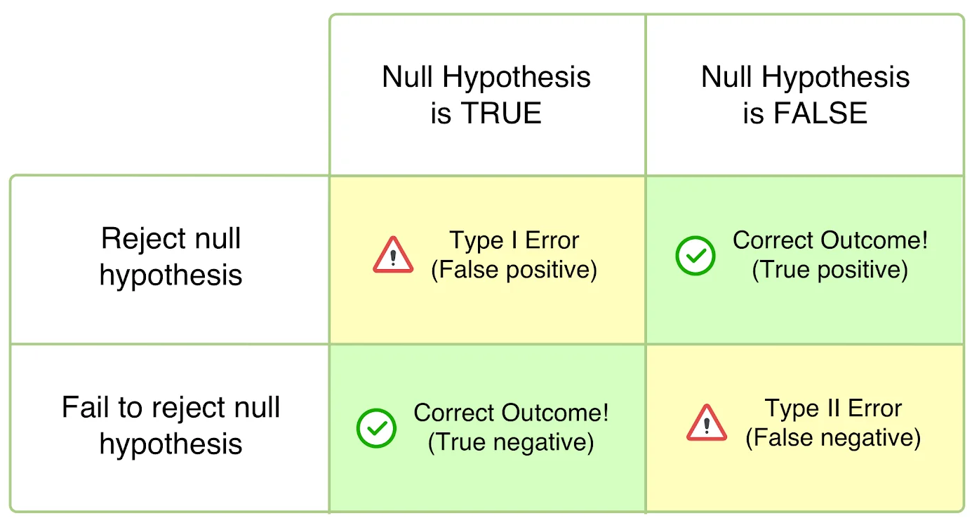
Type-I and Type-II errors
Rejecting the null hypothesis when it is true is a Type-I error
Accepting the null hypothesis when it is actually false is called a Type-II error

Slide 20
Measures of Association
Scatter plots depict the behavior of two attributes, and sometimes we can determine that the two attributes are related.
The appearance of a relationship is not enough evidence to draw conclusions.
Statistical techniques that can help us evaluate the likelihood that the relationship seen in the past will be seen again in the future.
We call these techniques measures of association, and the measures are supported by statistical tests that check whether the association is significant.

Slide 21
Pearson correlation coefficient
For normally distributed attribute values, the Pearson correlation coefficient is a valuable measure of association
Let’s consider two attributes, say x (size of a module) and y (number of faults in the module).
If the datasets of x and y values are normally distributed (or nearly), then we can form pairs (x_{i}, y_{i}), where there are i software items and we want to measure the association between x and y.
The total number of pairs is n, and for each attribute, we calculate the mean and variance. We represent the mean of the x values by m_{x}, and the mean of the y values by m_{y}. Likewise, var(x) is the variance of the set of x values, and var(y) is the variance of the y values. Finally, we calculate

Slide 22
Pearson correlation coefficient
The value of r, called the correlation coefficient, varies from −1 to 1.
When r is 1, then x and y have a perfect positive linear relationship; that is, when x increases, then so do y in equal linear steps.
Similarly, −1 indicates a perfect negative linear relationship (i.e., when x increases, y decreases linearly), and 0 indicates no relationship between x and y
Statistical tests can be used to check whether a calculated value of r is significantly different from zero at a specified level of significance; in other words, the computation of r must be accompanied by a test to indicate how much confidence we should have in the association (strength of association).
Chi-square test?

Slide 23
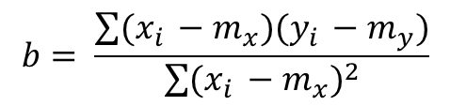
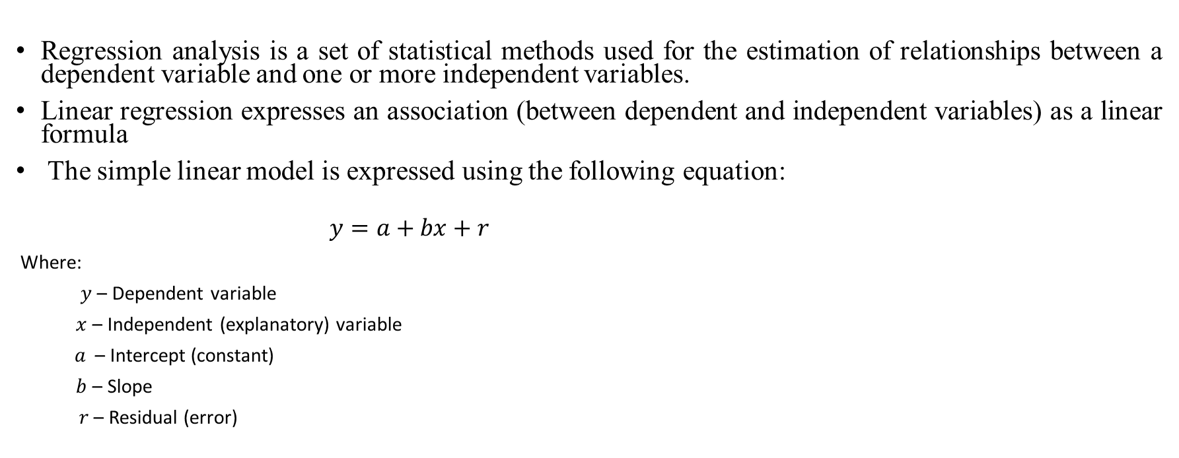

Linear Regression
Regression analysis is a set of statistical methods used for the estimation of relationships between a dependent variable and one or more independent variables.
Linear regression expresses an association (between dependent and independent variables) as a linear formula
The simple linear model is expressed using the following equation:
$$y=a+bx+r$$
Where:
$y$ – Dependent variable
$x$ – Independent (explanatory) variable
$a$ – Intercept (constant)
$b$ – Slope
$r$ – Residual (error)
$$b= \frac{\sum{(x_{i }−m_{x})(y_{i }−m_{y})}}{\sum{{(x_{i }−m_{x})}^{2}}}$$
$$a=m_{y}−bm_{x}$$

Slide 24
Linear Regression
The vertical distance from each point to the trend line represents the discrepancy between the data and the line. We need to keep the distance as small as possible.
The discrepancy for each point is called the residual, and the formula for generating the linear regression line minimizes the sum of the squares of residuals
The residuals values can be plotted (scatter plot) in a graph and can demonstrate if any values are unusually large.

Slide 25
Classification Tree Analysis
Often we want to know which measures provide the best information about a particular goal or behavior. That is which measures are best predictors of the behavior in a given attribute.
Classification tree analysis can be used to address this problem.
Suppose you want to determine which of the metrics are the best predictors of poor quality code modules among a large number of collected code module data.
+ poor quality;
- good quality

Slide 26
Principal Component Analysis (PCA)
Principal Component Analysis, or PCA, is a dimensionality-reduction method that is often used to reduce the dimensionality of large data sets, by transforming a large set of variables into a smaller one that still contains most of the information in the large set.
Reducing the number of variables of a data set naturally comes at the expense of accuracy, but the trick in dimensionality reduction is to trade a little accuracy for simplicity. Because smaller data sets are easier to explore and visualize and make analyzing data much easier and faster.
So to sum up, the idea of PCA is simple — reduce the number of variables of a data set, while preserving as much information as possible.

